Slide 1
Deep Inside Word2Vec
Bin Gao, Jiang Bian, and Tie-Yan Liu
MSRA IECA GROUP
Nov 2013
Collaborative work with Taifeng Wang, Qing Cui, Xiang Li, Xuan Hu, Hanjun Dai, Fei Tian, Rui Zhang

Slide 2
Outline
General Introduction
Documented Tricks
Undocumented Tricks
Where’s the Magic

Slide 3
Outline
General Introduction
Basic Models
Evaluation Results
Documented Tricks
Undocumented Tricks
Where’s the Magic

Slide 4
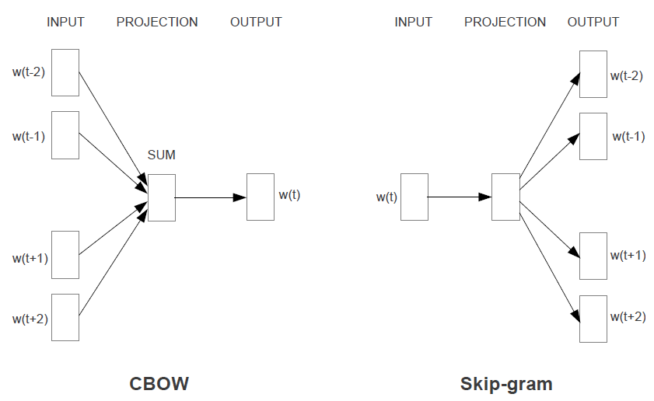
Basic Models of Word2vec
Word2vec
Tool for computing continuous distributed representations of words
Training data: text corpus (vocabulary-size 1-of-V vectors of single words)
Model file: word vectors (low-dimension embedding vectors)
CBOW and Skip-gram
References
[1] Mikolov et al, Efficient Estimation of Word Representations in Vector Space, ICLR 2013.
[2] Mikolov et al, Distributed Representations of Words and Phrases and their Compositionality, NIPS 2013.
[3] https://code.google.com/p/word2vec/

Slide 5
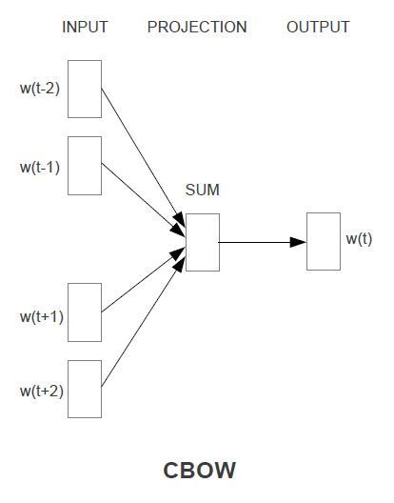
Closer Look at The Models – CBOW
Shared Projection Matrix
Model file: word vectors - M
M
w_{(t-2)}
w_{(t-1)}
M
M’
w_{(t)}
Sum
Training data: text corpus
M
Sliding window
w_{(t+1)}
Embedding Space
(D-dimension)
Vocabulary Space
(V-dimension)
… as a candidate for the Illinois state senate Obama had …
w_{(t+2)}
M
w_{(t-2)}
w_{(t-1)}
w_{(t)}
w_{(t+1)}
w_{(t+2)}
V: vocabulary size
1-of-V word representation: w_{(t+2)} = (0,…,0,1,0,…,0)^{T}
No activation function
Softmax in OUTPUT layer
Error back-propagation
Vocabulary Space
(V-dimension)
Embedding Space
(D-dimension)
state

Slide 6
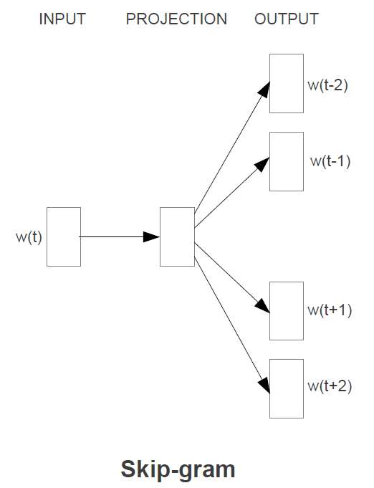
Closer Look at The Models – Skip-gram
Shared Projection Matrix
Model file: word vectors - M
M
w_{(t-2)}
CopyTo
M
w_{(t-1)}
w_{(t)}
M’
CopyTo
CopyTo
M
w_{(t+1)}
Training data: text corpus
Vocabulary Space
(V-dimension)
Embedding Space
(D-dimension)
Sliding window
CopyTo
M
w_{(t+2)}
… as a candidate for the Illinois state senate Obama had …
EqualTo
w_{(t-2)}
w_{(t-1)}
w_{(t)}
w_{(t+1)}
w_{(t+2)}
w_{(t)}
w_{(t’)}
Embedding Space
(D-dimension)
Vocabulary Space
(V-dimension)
V: vocabulary size
1-of-V word representation: w_{(t+2)} = (0,…,0,1,0,…,0)^{T}
state

Slide 7
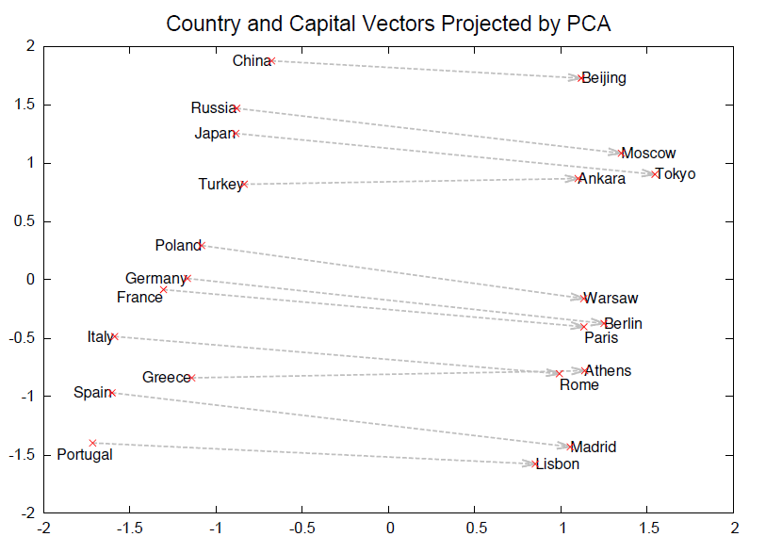
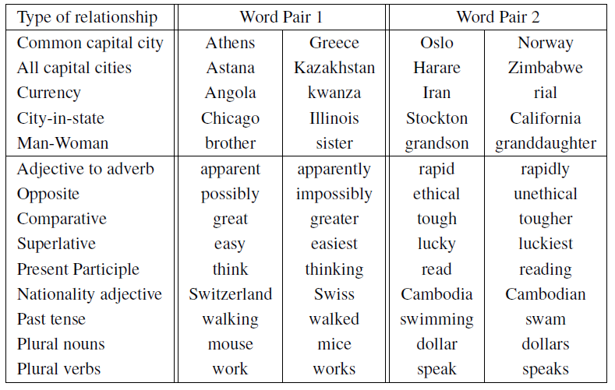
Evaluation Measures
Semantic-Syntactic Word Relationship
Embedding vector calculus:
Greece - Athens + Oslo = Norway
China - Beijing + Tokyo = Japan
greater - great + tough = tougher
Remark:
Another evaluation measure based on Microsoft Sentence Completion Challenge was also used.

Slide 8
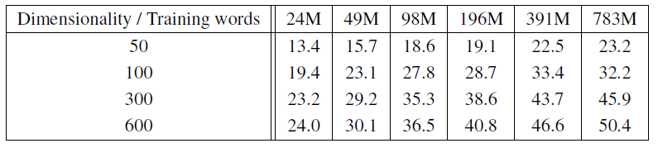
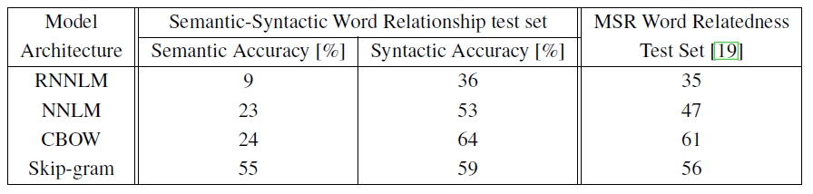
Evaluation Results
CBOW
Comparison of different model architectures
Setting
Only questions containing words from the top 30k words are used.
Observations
Higher embedding dimension leads to better accuracy.
Larger training data leads to better accuracy.
More training epochs can slightly improve the accuracy.
Setting
Embedding dimension: 640
MSR Word Relatedness Test Set is a Syntactic dataset.
Observations
CBOW and Skip-gram perform better than RNNLM[4] and NNLM[5].
Skip-gram performs slightly better than CBOW.
CBOW runs much faster than Skip-gram.
References
[4] Mikolov et al, Recurrent neural network based language model, Interspeech, 2010.
[5] Bengio et al, A neural probabilistic language model, JMLR, 2003.

Slide 9
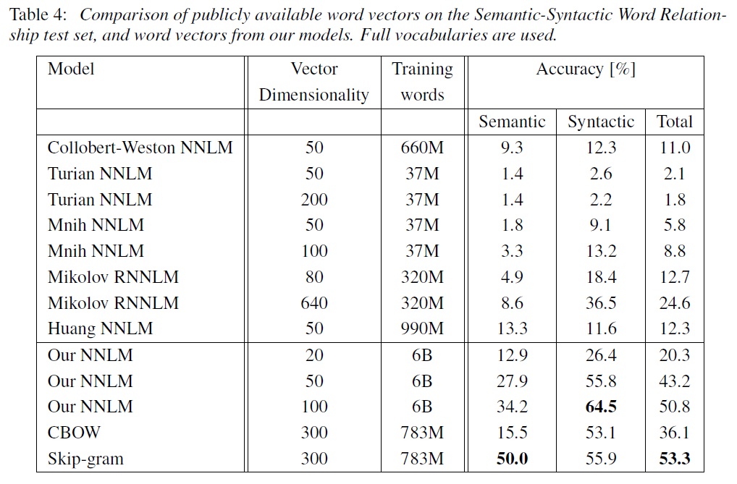
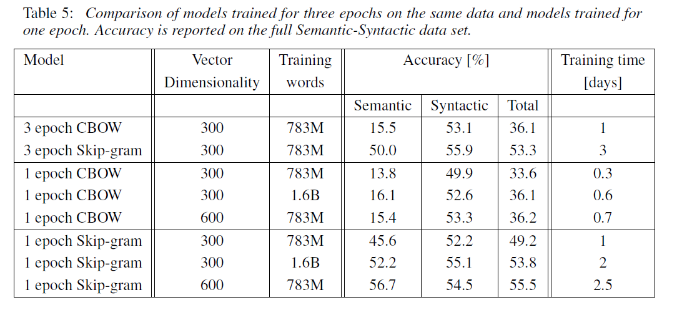
Evaluation Results
Observations
CBOW and Skip-gram perform better than RNNLM[4] and NNLM[5].
Skip-gram performs slightly better than CBOW.
CBOW runs much faster than Skip-gram.

Slide 10
Default Experimental Settings Used in This Study
Dataset | enwiki9
Training words (text stream) | 123.4M
Vocabulary size in training | 220k words
Representation dimensionality | 600
Epoch | 1
Vocabulary size in evaluation | 220k words
Seen evaluation questions | 100%, if a question is unseen, the accuracy on the question is regarded as 0
* Experimental results under other settings might be a little different, but most of the findings in this study should stay apply.

Slide 11
Outline
General Introduction
Documented Tricks
Huffman coding
Sub-sampling
Negative sampling
From words to phrases
Undocumented Tricks
Where’s the Magic

Slide 12
Huffman Coding: Basic Idea
Layer 1
Layer 2
Layer 3
The output layer is simply to large (at the scale of the entire vocabulary), which leads to slow training.
Compress the vocabulary using Huffman coding to reduce the size of the output layer.
Shared Projection Matrix
M
w_{(t-2)}
Huffman Tree
w_{(t-1)}
M
0
1
M’
0
1
0
1
Sum
M
0
1
w_{(t+1)}
Embedding Space
(D-dimension)
w_{(t)}
M
Leaf nodes:
Vocabulary Space in Huffman code
(e.g., w_{(t)} with code 001)
w_{(t+2)}
Vocabulary Space
(V-dimension)
Embedding Space
(D-dimension)

Slide 13

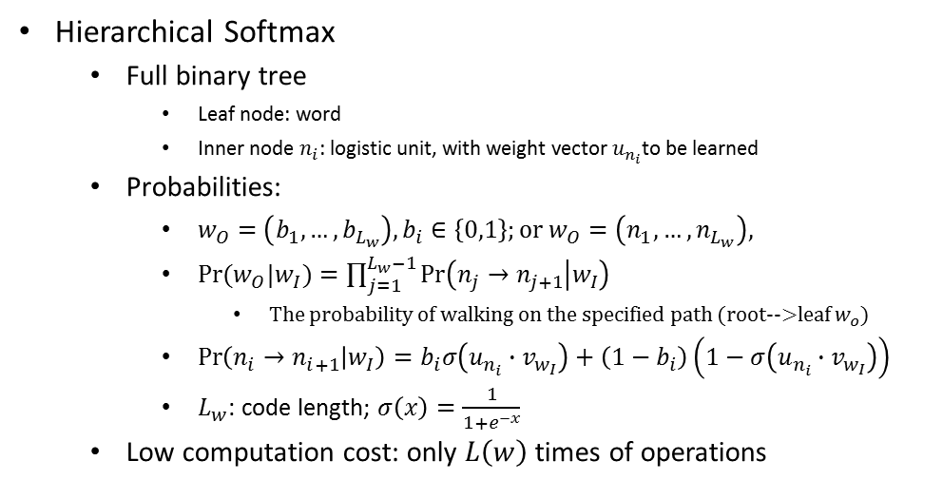

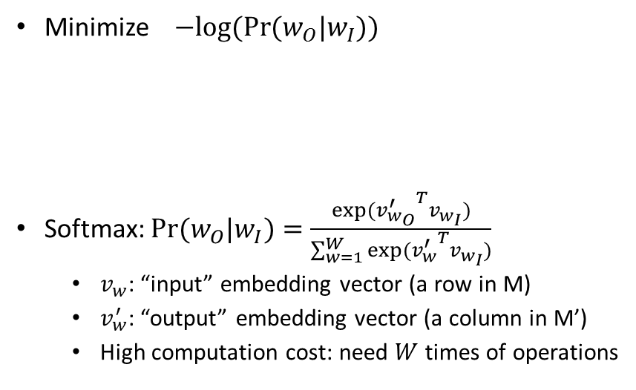


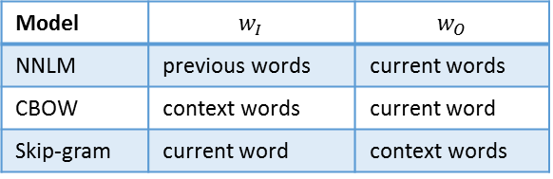

Huffman Coding: Theoretical Foundation
Minimize $−log⁡(Pr⁡(w_{O}|w_{I}))$
Softmax: $Pr⁡(w_{O}|w_{I})=\frac{exp⁡({v_{w_{O}}^{′}}^{T}v_{w_{I}})}{\sum_{w=1}^{W}{exp⁡({v_{w}^{′}}^{T}v_{w_{I}})}}$
$v_{w}$: “input” embedding vector (a row in M)
$v_{w}^{′}$: “output” embedding vector (a column in M’)
High computation cost: need $W$ times of operations
Hierarchical Softmax
Full binary tree
Leaf node: word
Inner node $n_{i}$: logistic unit, with weight vector $u_{n_{i}}$to be learned
Probabilities:
$w_{O}=\left(b_{1},…,b_{L_{w}}\right), b_{i}∈\left\{0,1\right\};or w_{O}=\left(n_{1},…,n_{L_{w}}\right),$
$Pr⁡(w_{O}|w_{I})=\prod_{j=1}^{L_{w}−1}{\operatorname{Pr}\left(n_{j}→n_{j+1} | w_{I}\right)}$
The probability of walking on the specified path (root-->leaf $w_{o}$)
$\operatorname{Pr}\left(n_{i}→n_{i+1} | w_{I}\right)=b_{i}σ\left(u_{n_{i}}∙v_{w_{I}}\right)+\left(1−b_{i}\right)\left(1−σ\left(u_{n_{i}}∙v_{w_{I}}\right)\right)$
$L_{w}$: code length; $σ\left(x\right)=\frac{1}{1+e^{−x}}$
Low computation cost: only $L\left(w\right)$ times of operations
Model | $$w_{I}$$ | $$w_{O}$$
NNLM | previous words | current words
CBOW | context words | current word
Skip-gram | current word | context words
$$n_{i}$$
0
1
Input
Projection
Output
Under the independent assumption for nodes on a tree branch, training with and without Huffman coding are proven to be equivalent.
M
M’
0
1
0
1
$$w_{I}$$
$$w_{O}$$
Remark:
$v_{w}$, $v_{w}^{′}$, and $u_{n_{i}}$ are all D-dimension embedding vectors.
0
1
Vocabulary Space
(V-dimension)
Embedding Space
(D-dimension)
Vocabulary Space
(V-dimension)
$w_{O}$ with code 001

Slide 14
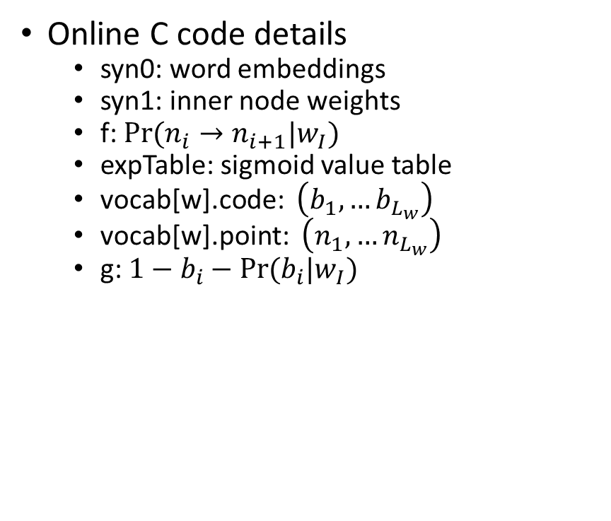
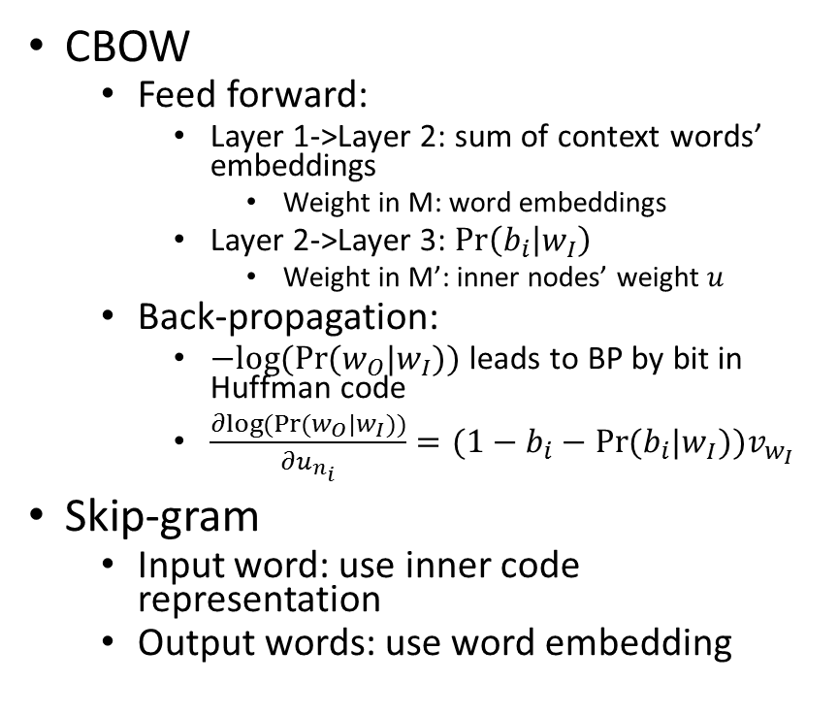
Huffman Coding: Detailed Implementations
CBOW
Feed forward:
Layer 1->Layer 2: sum of context words’ embeddings
Weight in M: word embeddings
Layer 2->Layer 3: $\operatorname{Pr}\left(b_{i} | w_{I}\right)$
Weight in M’: inner nodes’ weight $u$
Back-propagation:
$−log⁡(Pr⁡(w_{O}|w_{I}))$ leads to BP by bit in Huffman code
$\frac{∂log⁡(Pr⁡(w_{O}|w_{I}))}{∂u_{n_{i}}}=(1−b_{i}−Pr⁡(b_{i}|w_{I}))v_{w_{I}}$
Skip-gram
Input word: use inner code representation
Output words: use word embedding
Online C code details
syn0: word embeddings
syn1: inner node weights
f: $Pr⁡(n_{i}→n_{i+1}|w_{I})$
expTable: sigmoid value table
vocab[w].code: $\left(b_{1},…b_{L_{w}}\right)$
vocab[w].point: $\left(n_{1},…n_{L_{w}}\right)$
g: $1−b_{i}−Pr⁡(b_{i}|w_{I})$

Slide 15
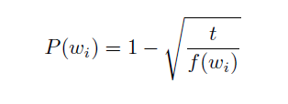
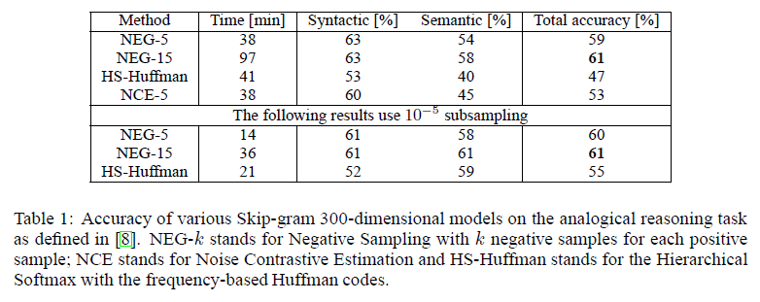
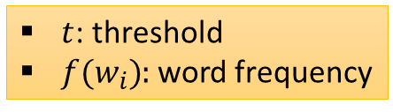
Sub-sampling
Discard a word with the following probability
$t$: threshold
$f(w_{i})$: word frequency
Many frequent words are stop words that contain little semantics
Subsampling balances between rare and frequent words

Slide 16
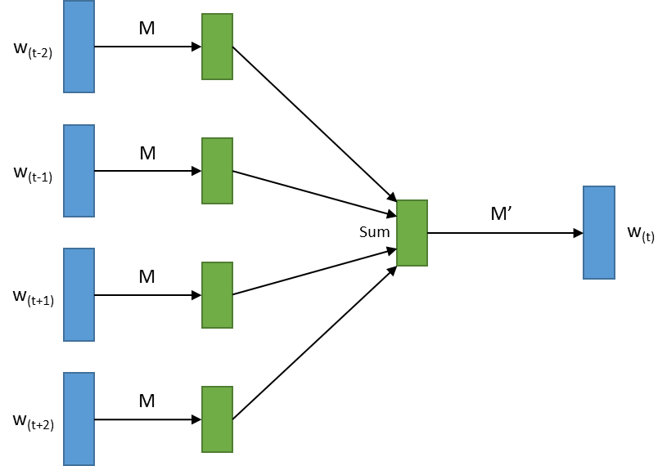
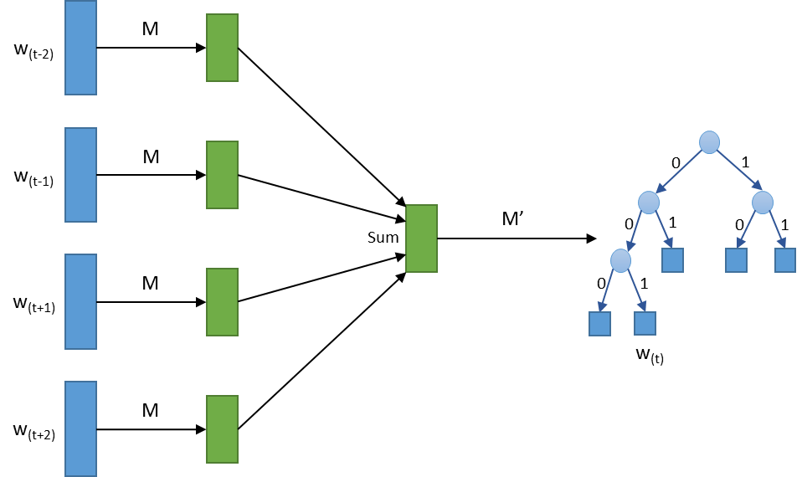
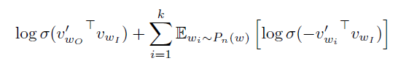
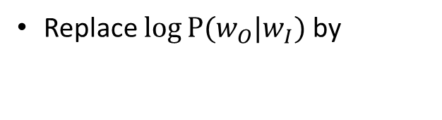
Negative Sampling
w_{(t)} = (0,…,0,1,0,…,0)^{T}
w_{(t)} = (b₁,…,b_{Lw})^{T}
w_{(t)} = (?,…,?,0,?...,1,…?,0,?...,?)^{T}
Original CBOW
CBOW with Huffman Coding
CBOW with Negative Sampling
Replace $\log{P⁡(w_{O}|w_{I})}$ by
In the original CBOW model, related words (e.g., synonym) are regarded as negative outputs, which may hurt the training process.
With negative sampling, only a few randomly selected words (unlikely to be related) are treated as negative outputs.

Slide 17
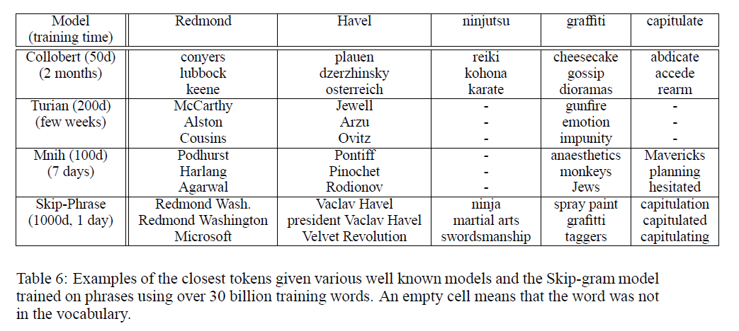
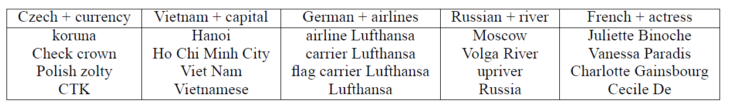
From Words to Phrases
Skip-phrase by hyphenation: machine learning → machine_learning
Skip-Phrase uses the largest dimension 1000d.
Skip-Phrase supports the calculation of phrase embedding.
Skip-Phrase uses 30B training words.
The NIPS 2013 paper [2] only showed some examples. No accuracy reported.

Slide 18
Outline
General Introduction
Documented Tricks
Undocumented Tricks
Input processing
Sliding window size
SUM/AVER of embedding vectors
Weight on input/output
Stop words dropping
Visualized Evaluation
Where’s the Magic

Slide 19
Input File Processing
Raw data are original XML dumps from Wikipedia, which contain markups, labels, links, and special symbols
Data processing:
Keep text between "<text></text>" labels
Completely remove XML/HTML tags, icons, tables, references between “<ref></ref>”
Partially remove:
URLs, but preserve visible text of URL
Image links, but preserve image caption
Markup of categories, but preserve the text
Most URL encoded chars are removed, but preserve and decode '<', '>' and '&‘
Convert:
All letters into lower case
All digits into English words
All other chars into spaces

Slide 20
Input Stream Chunking
If the input stream has been separated into sentences, one sentence will be loaded each time, and only words in the same sentence will exist in the same training example
End of sentence is treated as a special word "</s>"
BUT, the processed data by published at Word2Vec website does not contain sentence-breaking symbols
If there is no sentence separation, the codes will then load a buffer with the size of 1000 words each time (after subsampling).
How about introducing sentence break?
After we break input stream into sentences by the delimiter "</s>“, the accuracy is increased from 25.50% into 27.20%.
Finer sentence-breaking may lead to some improvement, but not significant

Slide 21
Implicit Input Layer
Shared Projection Matrix
Traditional way:
Feed-forward: matrix multiplication between input layer w_{(t±i)} and embedding matrix M
High computation cost
M
w_{(t-2)}
w_{(t-1)}
M
M’
Tricks used by Word2Vec:
No explicit input layer
Since w_{(t±i)} is a 1-of-v vector, the corresponding representation vector is the specific row of embedding matrix M
Using/updating the specific row of M directly during feed-forward and back-propagation
Sum
w_{(t)}
M
w_{(t+1)}
Embedding Space
(D-dimension)
Vocabulary Space
(V-dimension)
w_{(t+2)}
M
Using implicit input layer can greatly reduce the computational complexity.
Vocabulary Space
(V-dimension)
Embedding Space
(D-dimension)

Slide 22
Outline
General Introduction
Documented Tricks
Undocumented Tricks
Input processing
Sliding window size
SUM/AVER of embedding vectors
Weight on input/output
Stop words dropping
Visualized Evaluation
Where’s the Magic

Slide 23
Window Size Randomization
w_{(t-k)}
Tricks used by Word2Vec
Although setting a certain window size, for each training example, it will randomly discard some words from the front and end part of the window
Randomly discard b words
w_{(t-k+1)}
Window size = 2k
…
w_{(t-1)}
SUM or AVER
w_{(t)}
w_{(t+1)}
Natural Questions:
Does random window size benefit the performance?
What is the best window size?
…
w_{(t+k-1)}
w_{(t+k)}

Slide 24
Window Size – Fixed vs. Random
Observations:
With small window size, using fixed window size can achieve better accuracy than using random size
However, large fixed window size will hurt the accuracy
Questions:
As word2vec SUM up all input word embeddings in the window, different window sizes many result in different scale, is it a bug?

Slide 25
Outline
General Introduction
Documented Tricks
Undocumented Tricks
Input processing
Sliding window size
SUM/AVER of embedding vectors
Weight on input/output
Stop words dropping
Visualized Evaluation
Where’s the Magic?

Slide 26
SUM/AVER of Embedding Vectors
w_{(t-k)}
Confusions in Word2Vec
Paper texts indicates the used of AVER
Paper figure uses SUM instead
Code uses SUM
w_{(t-k+1)}
…
w_{(t-1)}
SUM or AVER
w_{(t)}
w_{(t+1)}
Questions:
Which one is better, SUM or AVER?
…
w_{(t+k-1)}
w_{(t+k)}

Slide 27
Fixed vs. Random with AVER
Observations:
When using AVER, random window size outperforms fixed window size; and both are better than using SUM
Why:
AVER normalizes different window sizes
Randomization puts higher weights on those words near the target word, which corresponds to a linear position weighting scheme.
Fixed window corresponds to a uniform position weighting scheme.
Questions:
Is there better position weighting scheme?

Slide 28
Position Weighting Scheme – Gaussian vs. Uniform
Gaussian position weighting scheme outperform linear position weighting scheme (corresponding to randomized window size) with appropriate variance

Slide 29
Outline
General Introduction
Documented Tricks
Undocumented Tricks
Input processing
Sliding window size
SUM/AVER of embedding vectors
Weight on input/output
Stop words dropping
Visualized Evaluation
Where’s the Magic?

Slide 30
Input: Binary Weight vs. Frequency-based Weight
w_{(t-k)}
Binary weights are used in Word2vec:
In one training example, each input word yields the same importance in both FF and BP
The rare words’ embedding may not be learned adequately
while those of popular words are likely to be over-trained
w_{(t-k+1)}
…
w_{(t-1)}
SUM or AVER
w_{(t)}
w_{(t+1)}
Question:
What about putting higher weights to rare words and lower weights on popular words?
…
w_{(t+k-1)}
w_{(t+k)}

Slide 31
Input: Frequency-based Weights
Weights tried:
Inverse Huffman code length
IDF – Inverse “document” frequency
Normalized IDF –
(IDF-minIDF)/(maxIDF-minIDF)
Combination of input weighting and subsampling
Putting appropriate weights on input words improves accuracy
IDF, especially normalized IDF, performs very well as word weight
Combining input weighting and subsampling can reach even better performance

Slide 32
Output: BP-by-bit vs. Weighted BP
w_{(t-k)}
In Word2vec:
Back-propagate the error on each bit of the output Huffman codes
Theory shows its equivalence with the training scheme without Huffman coding
w_{(t-k+1)}
…
w_{(t-1)}
SUM or AVER
w_{(t)}
Question:
The theory is valid under the independent assumption. What if the assumption does not hold?
Shall we assign different weights to different bits during BP?
w_{(t+1)}
…
w_{(t+k-1)}
w_{(t+k)}

Slide 33
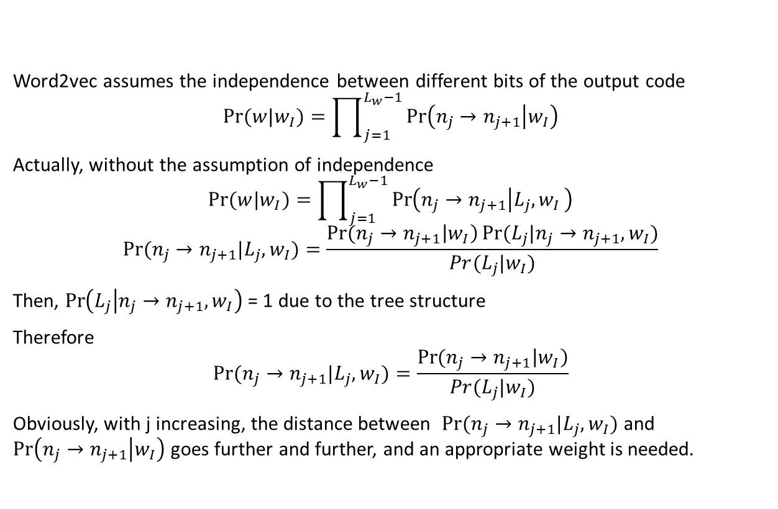
Output: Theoretical Foundation Revisited
Word2vec assumes the independence between different bits of the output code
$$Pr⁡(w|w_{I})=\prod_{j=1}^{L_{w}−1}{\operatorname{Pr}\left(n_{j}→n_{j+1} | w_{I}\right)}$$
Actually, without the assumption of independence
$$Pr⁡(w|w_{I})=\prod_{j=1}^{L_{w}−1}{\operatorname{Pr}\left(n_{j}→n_{j+1} | L_{j}{,w}_{I}\right)}$$
$$Pr⁡(n_{j}→n_{j+1}|{L_{j},w}_{I})=\frac{\operatorname{Pr}{(n_{j}→n_{j+1}\left|w_{I}\right)}Pr⁡(L_{j}|n_{j}→n_{j+1}, w_{I})}{Pr(L_{j}|w_{I})}$$
Then, $\operatorname{Pr}\left(L_{j} | n_{j}→n_{j+1}, w_{I}\right)$ = 1 due to the tree structure
Therefore
$$Pr⁡(n_{j}→n_{j+1}|{L_{j},w}_{I})=\frac{\operatorname{Pr}{(n_{j}→n_{j+1}\left|w_{I}\right)}}{Pr(L_{j}|w_{I})}$$
Obviously, with j increasing, the distance between $Pr⁡(n_{j}→n_{j+1}|{L_{j},w}_{I})$ and $\operatorname{Pr}\left(n_{j}→n_{j+1} | w_{I}\right)$ goes further and further, and an appropriate weight is needed.
Output Code (e.g. Huffman tree)
Higher position
0
1
0
1
0
1
0
1
Lower position
w_{(t)}
Assumption of independence between different bits of the output code results in the under-estimation of the effects of lower positions

Slide 34
Output: Weighting the Bits in Huffman Codes
Weights tried:
W1: (bit position/code length)
W2: (bit position/code length)^2
W3: (bit position/code length)^3
Putting appropriate weights on the errors from different bits of Huffman codes significantly improve the accuracy of word embedding

Slide 35
Outline
General Introduction
Documented Tricks
Undocumented Tricks
Input processing
Sliding window size
SUM/AVER of embedding vectors
Weight on input/output
Stop words dropping
Visualized Evaluation
Where’s the Magic?

Slide 36
Stop Words Dropping
Word2Vec uses subsampling to implicitly achieve the removal of stop words.
Question: How about explicitly removing stop words?
Subsampling yields more benefit to the accuracy than explicitly removing stop words
Some stop words may play as important context information to the embedding of some words

Slide 37
Outline
General Introduction
Documented Tricks
Undocumented Tricks
Input processing
Sliding window size
SUM/AVER of embedding vectors
Weight on input/output
Stop words dropping
Visualized Evaluation
Where’s the Magic

Slide 38
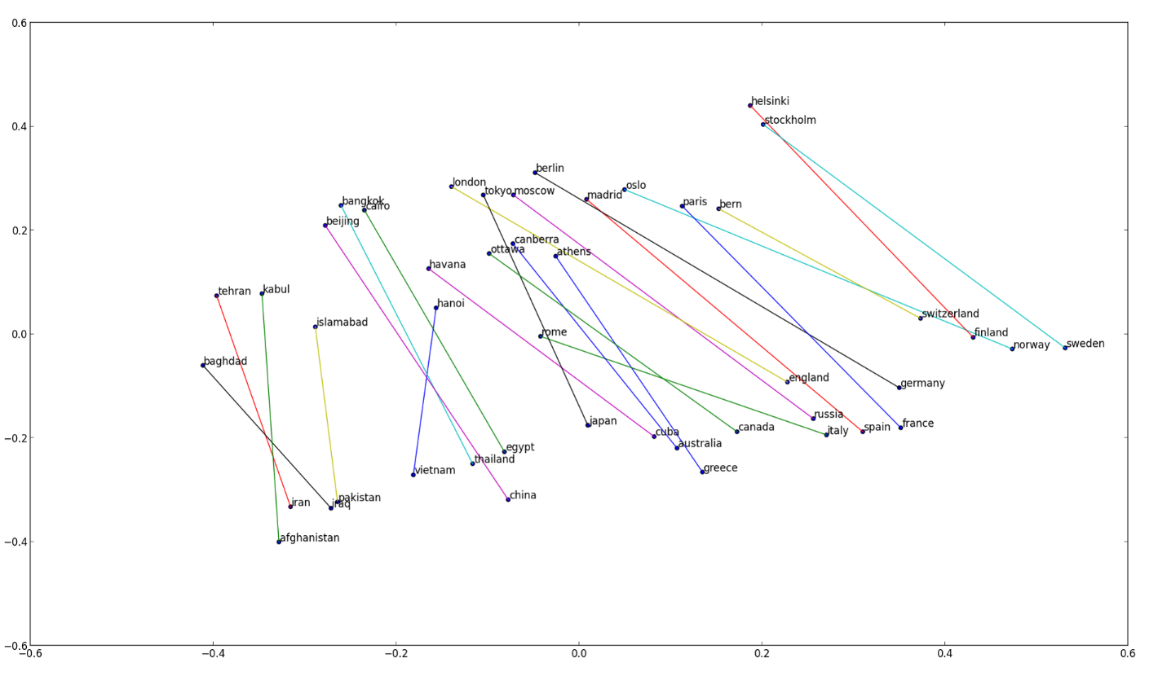
Visualization using 2-D PCA
Baseline
Total Accuracy | 26.65%
Semantic Accuracy | 16.62%
Syntactic Accuracy | 34.98%
It was claimed that parallel lines indicate linear regularity between concepts!

Slide 39
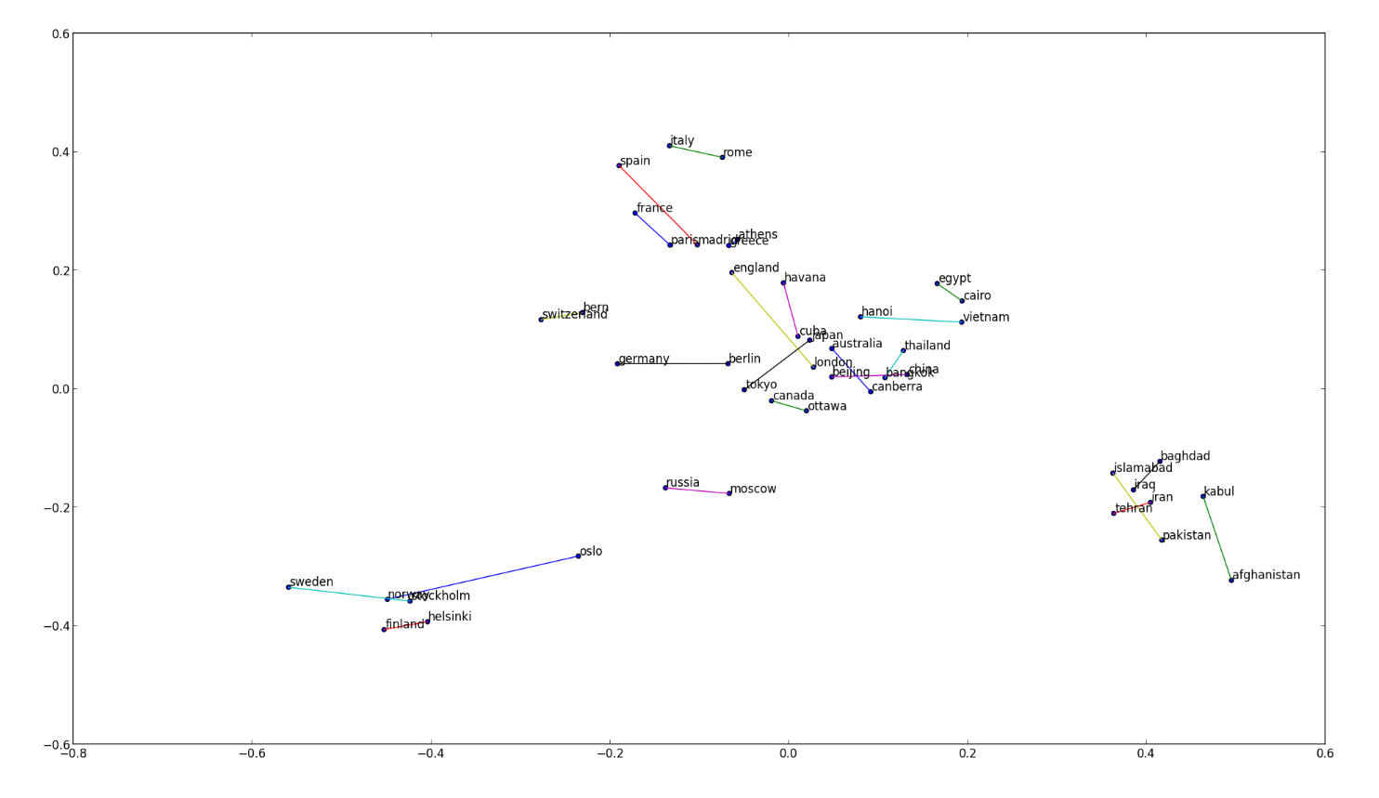
The Claim Might not Be True!
Baseline + Sub-sampling
Total Accuracy | 30.97%
Semantic Accuracy | 38.05%
Syntactic Accuracy | 25.08%
Poorer parallelism corresponds to even better accuracy!
2-D PCA simply cannot represent the complex geometry structure in the 600-D embedding space!

Slide 40
Outline
General Introduction
Documented Tricks
Undocumented Tricks
Where’s the Magic?

Slide 41
Magic of Word2Vec
Word2Vec was described as a new deep learning algorithm, and its ability of mining semantics of words was attributed to the proposed CBOW and Skip-Gram models
To understand whether this is true, we tested very simple baselines that count frequency of surrounding words without any fancy model
Use frequencies of the surrounding words as the word feature
Use tf-idf of the surrounding words as the word feature
PCA based on the above features (similar to Eigenwords)
Sliding windows in training data:
of the state of emergency
the Illinois state senate Obama
state = (0,39,0,…,2,…,102,…,0)^{T}
…
way to state an opinion

Slide 42
Counting Model vs. word2vec
Model | Setting (window = 5) |  | Total Accuracy | Semantic Accuracy | Syntactic Accuracy
word2vec | Random window + SUM | 600d | 25.50% | 14.13% | 34.94%
word2vec | Fixed window + AVER | 600d | 34.57% | 27.26% | 40.64%
Counting model | Frequency | 30000d | 18.33% | 28.27% | 10.07%
Counting model | tf-idf |  | 26.57% | 36.16% | 18.60%
Counting model | (Log tf)-idf |  | 38.13% | 52.33% | 26.34%
Counting model | Frequency | 30000d; Remove stop words | 31.21% | 46.16% | 18.78%
Counting model | tf-idf |  | 30.17% | 43.09% | 19.44%
Counting model | (Log tf)-idf |  | 39.00% | 56.30% | 24.63%
Counting model | (Log tf)-idf | 600d by PCA | 40.93% | 41.53% | 40.43%
Counting model | (Log tf)-idf | 300d by PCA | 43.26% | 39.88% | 46.07%
Surrounding texts contribute to the “magic” results but not CBOW or Skip-gram.
To some extent, the models used in Word2Vec even heavily damage the semantic accuracy as compared with the simple counting model.

Slide 43
Conclusion
Engineering tricks used by Word2Vec have their values, and can be improved
Window size selection and randomization
Weighting on input and output
Sub-sampling and stop words dropping
… …
Word2Vec is not as magic as imagined
It is the surrounding words that contain the information to produce semantic word embedding
Even simple counting model can achieve good results based on surrounding words
The CBOW and Skip-gram models are even less effective than simple counting

Slide 44
Disclaimer
The experimental results, statements, and conclusions in the slides are only for Microsoft internal discussions. All the experimental results are based on a set of small-scale experiments on one special dataset with a certain setting schema. The statements and conclusions are drawn only based on these experimental results.

Slide 45


